Slide 1

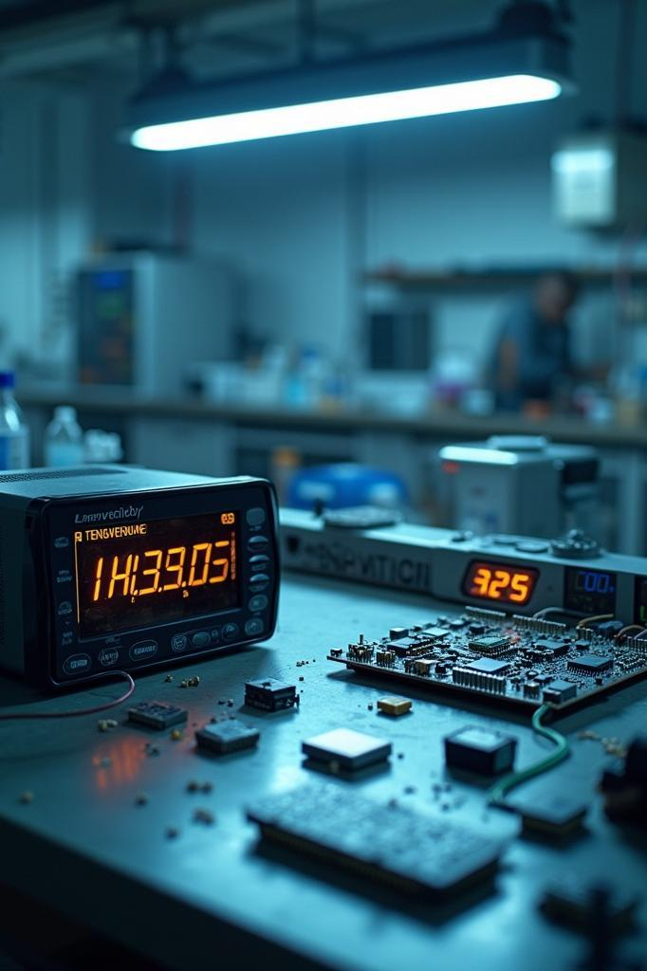
Embedded Systems Project
Temperature and Humidity Measurement
By Văn Thiên Lâm - 2151110

Slide 2
Outline
1/ Introduction
2/ Schematic
3/ PCB implement
4/ Result

Slide 3
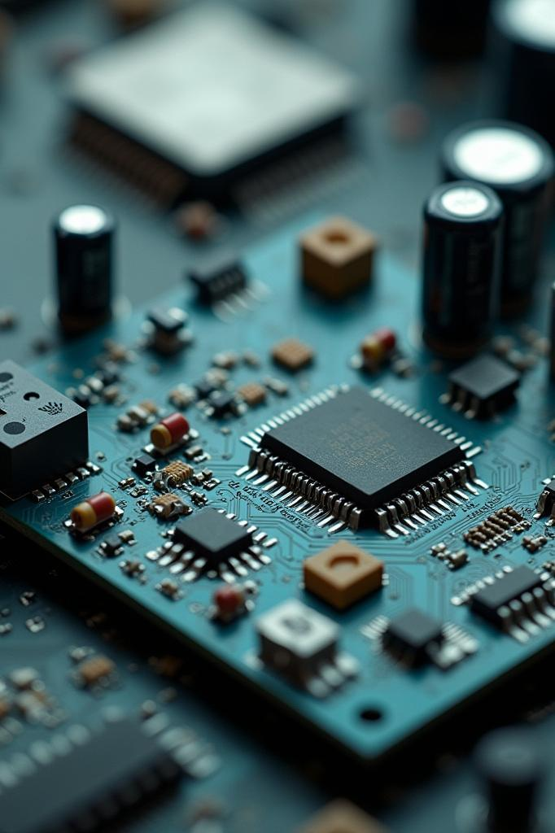
INTRODUCTION
01
Temperature and Humidity Measurement:
Wide used in many applications: smart house, smart agriculture, storage,…
Design requirement:
Small size
Replaceable components
Power supply protection

Slide 4
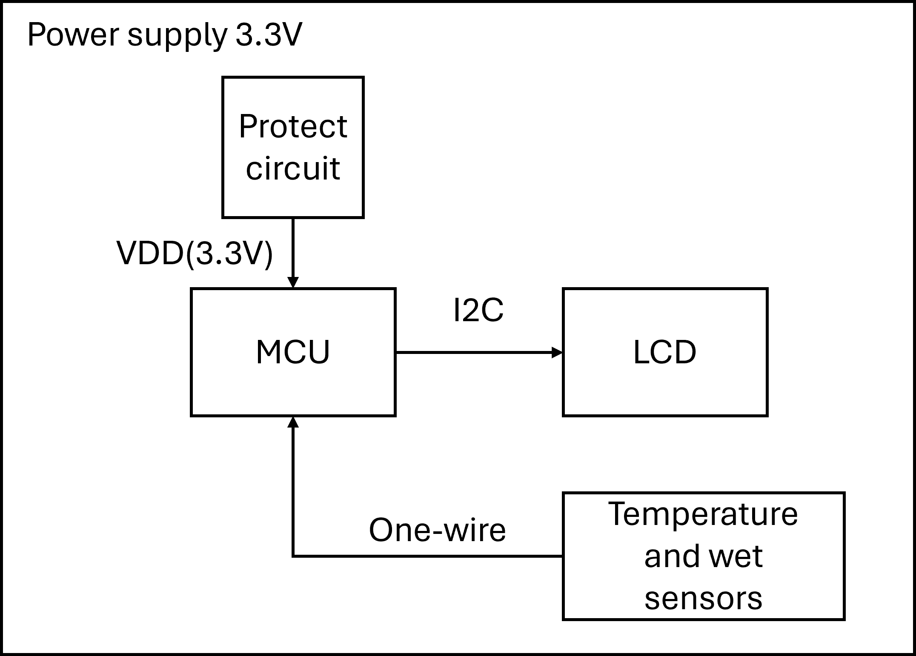
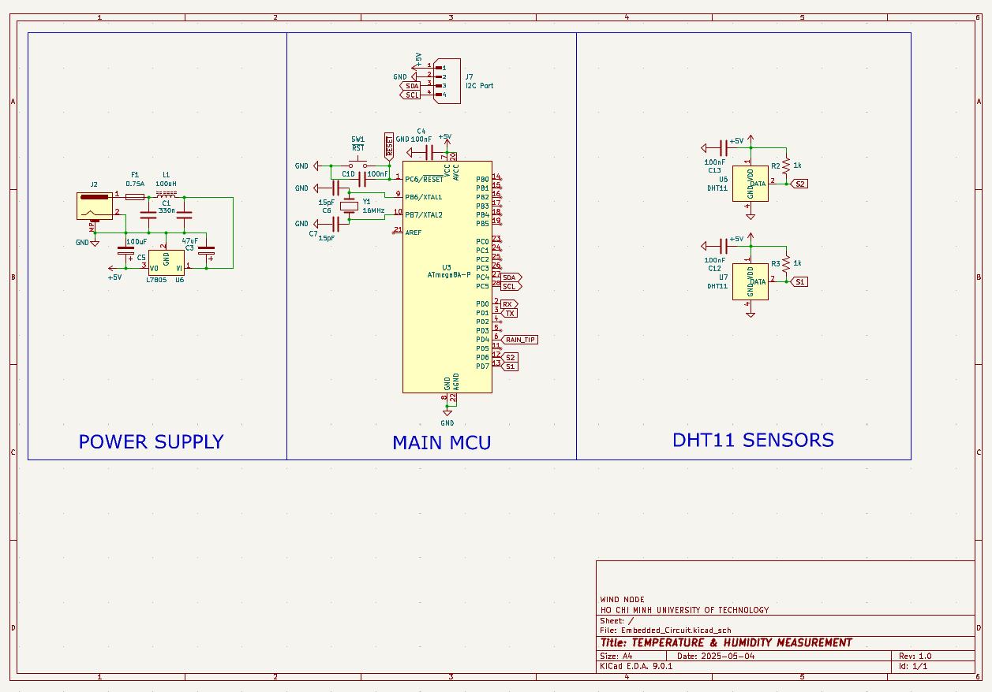
SCHEMATIC
02
5V
Fig1. Block diagram in concept phase
Fig2. Final schematic

Slide 5
SCHEMATIC
02
Table1. Components selection
Component | Description | Specification
ATMEGA8A | Main MCU | - Cheaper than ATMEGA328P - Enough I/O
Crystal 16MHz | For MCU | - Maximum clock for MCU
Reset SW1 | Reset MCU | - Press >5s
LM7805 | Clean Power supply for MCU | - 5V to 3.3V
Fuse | Protect MCU due to over-current (750mA) | Maximum current = 750mA
LC pi filter | Low-pass filter
2 DHT11 | Measure temp. & humidity | Cheap Easy to buy & replace Temp: 0-50°C
LCD with I2C | User interface | Easy to replace & used
Fig2. Final schematic

Slide 6
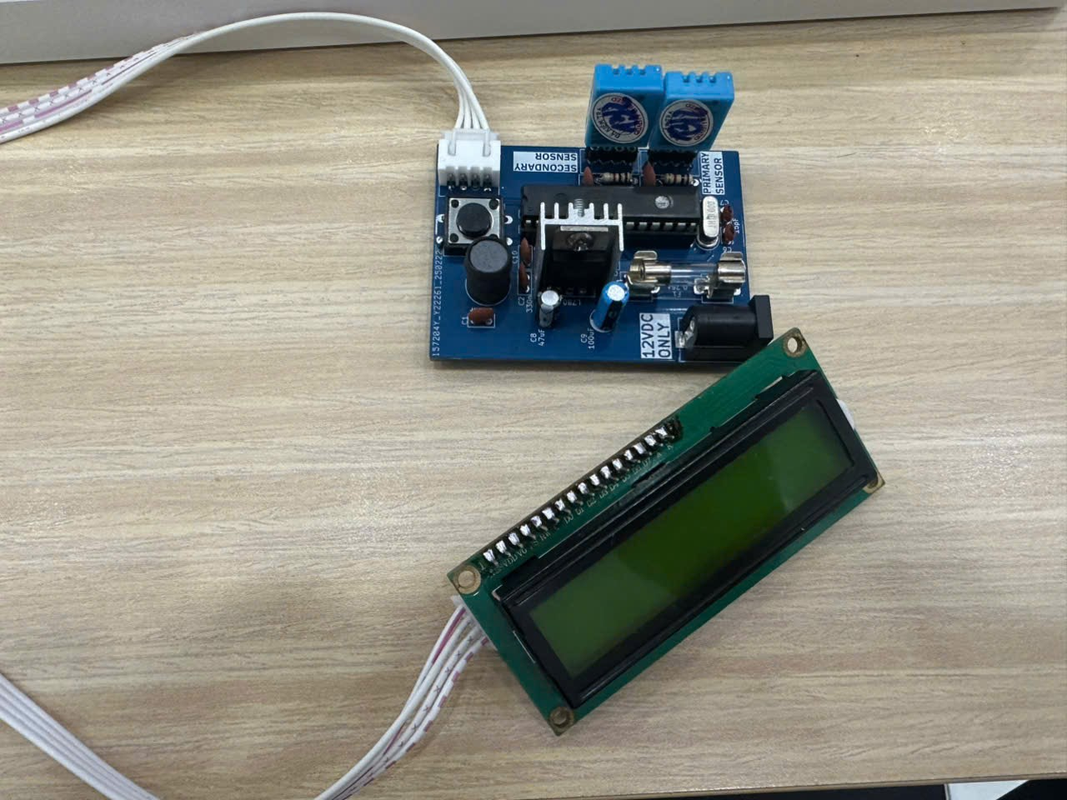
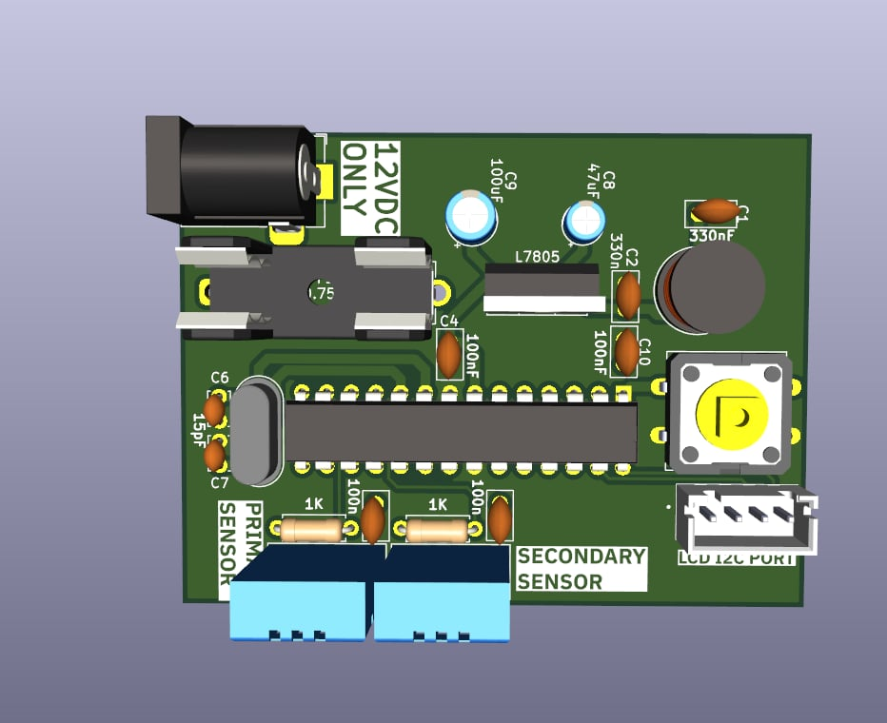
PCB
03
Fig3. PCB design (2 layer)
Fig4. Prototype

Slide 7
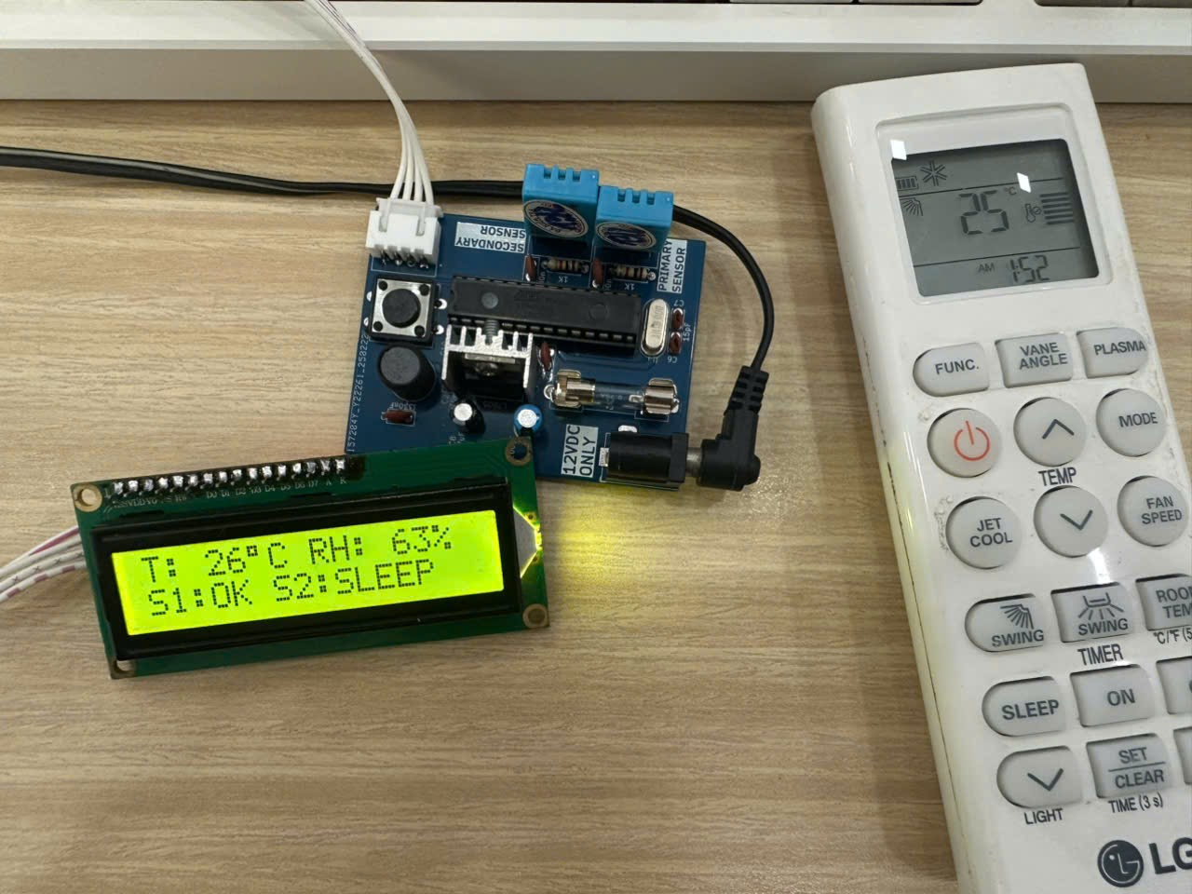
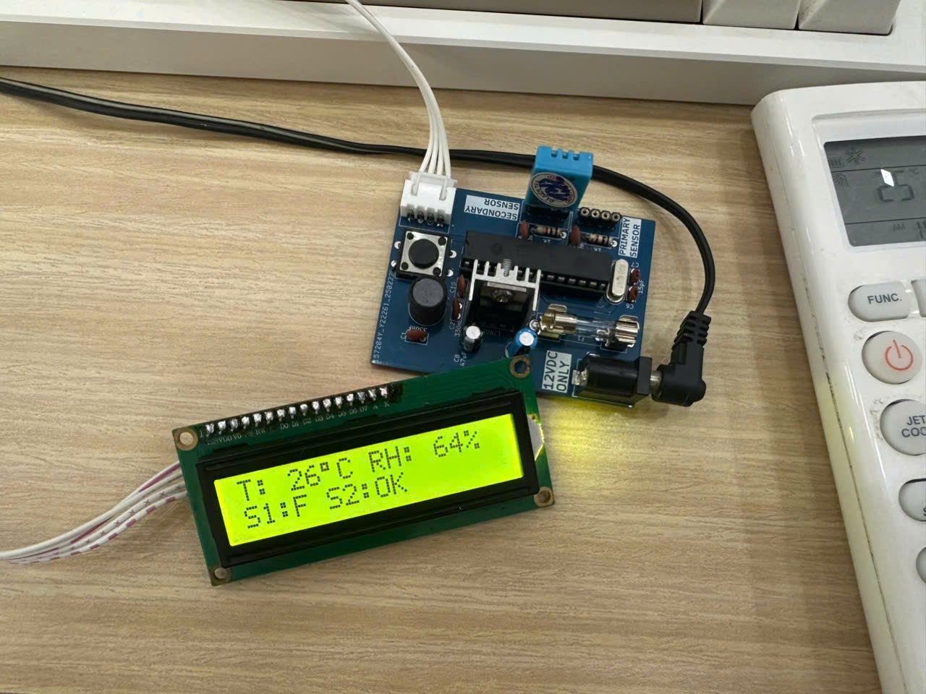
Result
04
Fig5a. Test design in 25°C room
Fig5b. Test design in 25°C room
(disconnect primary sensor)

Slide 8
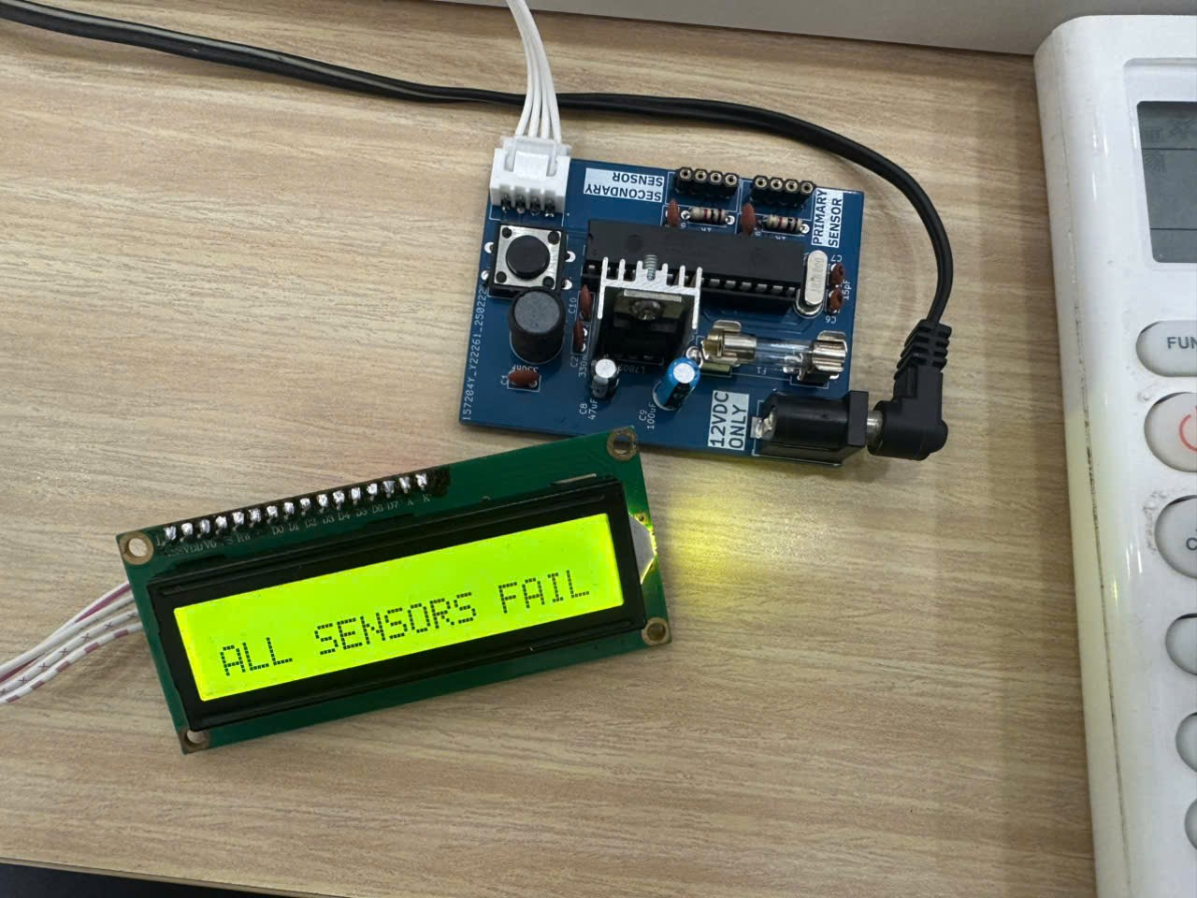
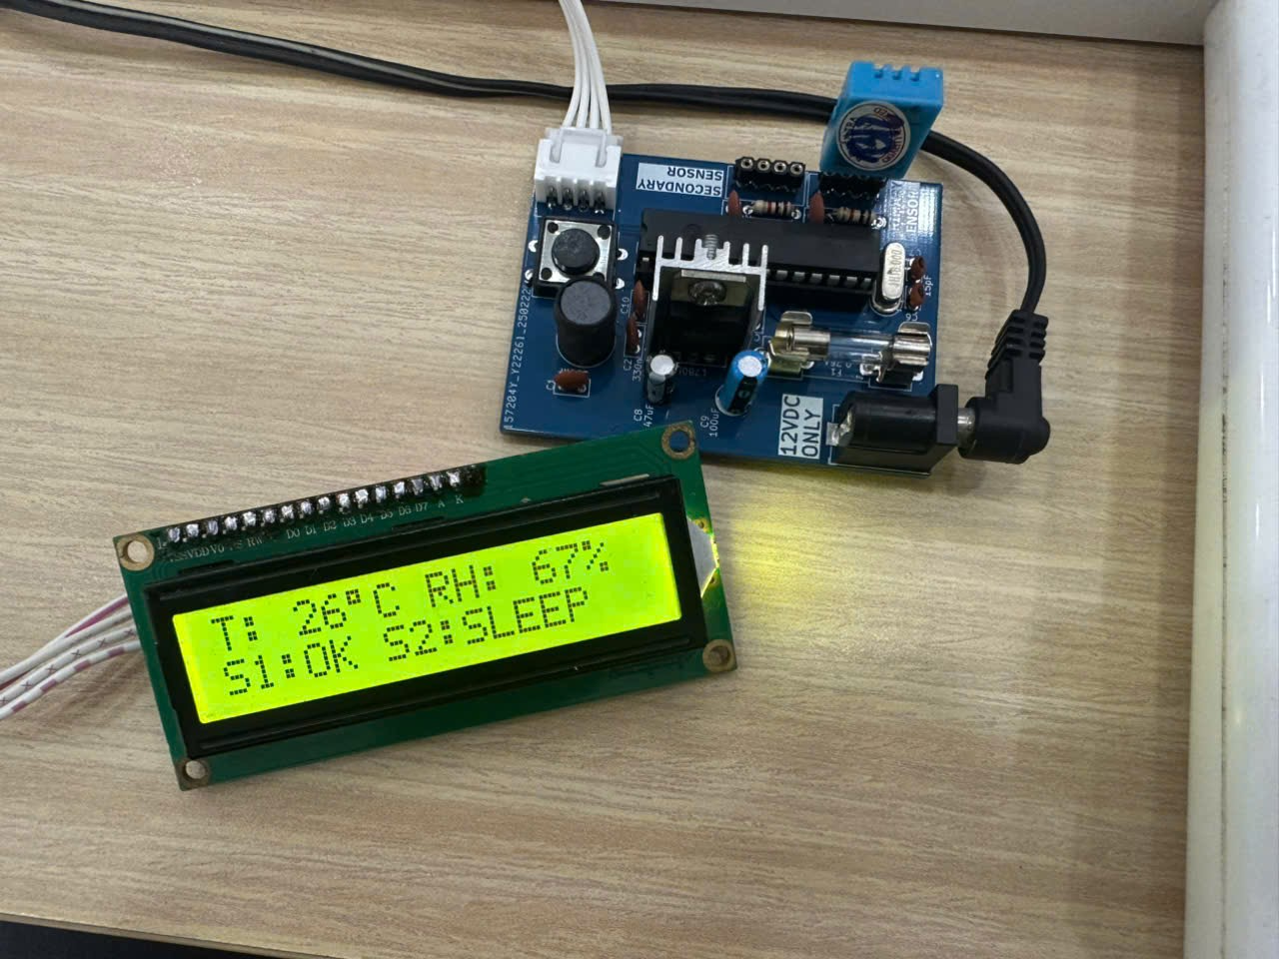
Result
04
Fig5c. Test design in 25°C room
(disconnect both sensor)
Fig5d. Test design in 25°C room
(disconnect secondary sensor)

Slide 9
THANK YOU

